Slide 1





Hospital Data Analysis:

Slide 2
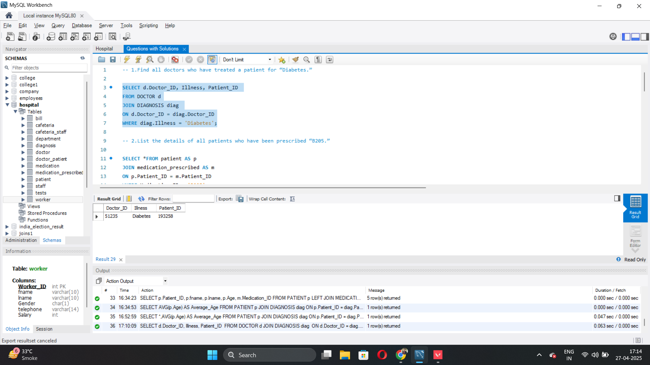
1.Find all doctors who have treated a patient for “Diabetes.”
SELECT d.Doctor_ID, Illness, Patient_ID
FROM DOCTOR d
JOIN DIAGNOSIS diag
ON d.Doctor_ID = diag.Doctor_ID
WHERE diag.Illness = 'Diabetes';

Slide 3

2. List the details of all patients who have been prescribed “B205.”
SELECT *FROM patient AS p
JOIN medication_prescribed AS m
ON p.Patient_ID = m.Patient_ID
WHERE Medication_ID = 'B205';

Slide 4
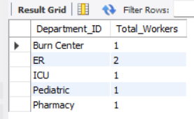
3. Find the total number of workers in each
department.
SELECT d.Department_ID, COUNT(w.Worker_ID) AS Total_Workers
FROM DEPARTMENT d
JOIN DOCTOR doc ON d.Department_ID = doc.Department_ID
JOIN WORKER w ON doc.D_Worker_ID = w.Worker_ID
GROUP BY d.Department_ID;
Threats

Slide 5

4. Retrieve the names and phone numbers of all patients who have been diagnosed with “Diabetes.”
SELECT p.fname, p.lname, telephone, Illness
FROM patient AS p
JOIN diagnosis AS d
ON p.Patient_ID = d.Patient_ID
WHERE Illness = 'Diabetes';

Slide 6
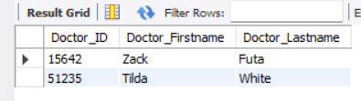
5. Get the names and IDs of all doctors who work in the “ER” department.
SELECT d.Doctor_ID, w.fname AS Doctor_Firstname, w.lname AS Doctor_Lastname
FROM doctor AS d
JOIN worker AS w
ON d.D_Worker_ID = w.Worker_ID
WHERE Department_ID = 'ER';

Slide 7
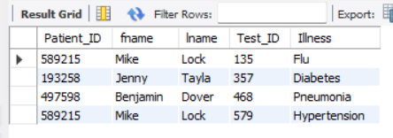
6. List all patients who had a test conducted with a positive result (Result = 1).
SELECT p.Patient_ID, p.fname, p.lname, t.Test_ID, t.Illness
FROM PATIENT p
JOIN TESTS t ON p.Patient_ID = t.Patient_ID
WHERE t.Result = 1;

Slide 8

7.Find the total salary expenditure for all workers.
SELECT SUM(Salary) AS Total_Salary_Expenditure
FROM WORKER;

Slide 9
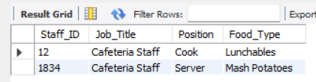
8. List all cafeteria staff along with their job position and the food type served in their assigned cafeteria.
SELECT cs.Staff_ID, s.Job_Title, cs.Position, c.Food_Type
FROM CAFETERIA_STAFF cs
JOIN STAFF s ON cs.Staff_ID = s.Staff_ID
JOIN CAFETERIA c ON cs.Cafeteria_ID = c.Cafeteria_ID;

Slide 10
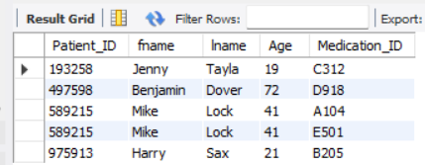
9. Show details of patients along with the medication they are prescribed, even if no medication has been prescribed.
SELECT p.Patient_ID, p.fname, p.lname, p.Age, m.Medication_ID
FROM PATIENT as p
LEFT JOIN MEDICATION_PRESCRIBED as mp ON p.Patient_ID = mp.Patient_ID
LEFT JOIN MEDICATION as m ON mp.Medication_ID = m.Medication_ID;

Slide 11
10. Find the average age of patients diagnosed with “Flu.”
SELECT *,AVG(p.Age) AS Average_Age
FROM PATIENT p
JOIN DIAGNOSIS diag ON p.Patient_ID = diag.Patient_ID
WHERE diag.Illness = 'Flu';

